Slide 2

Families supporting families of children with special healthcare needs, chronic illnesses, and disabilities

Slide 3
Hannah Vickery, Communications Specialist
Tonya Bowman, Family Voices Support Specialist

Slide 4
Webinar Etiquette
You have been muted by the webinar hosts. Please stay muted for the duration of the webinar, with the exception of the scenarios discussion.
Your video has been turned off by the hosts. Please keep your video off for the duration of the webinar.
You may enter your questions into the chat box. Depending on time, we will have a Q&A session at the end for any questions in the chat box.
We will be sending out a survey after the webinar – please complete the survey as you have time.

Slide 5
hannah_v@tndisability.org tonya_b@tndisability.org 615-383-9442

Slide 6
Creating a Society that Values, Includes, and Supports Tennesseans with Disabilities

Slide 7


Slide 8
Why the ADA Matters
30th Anniversary this year
The ADA is a civil rights law with the intent of making sure everyone has a seat at the table and is able to exercise our rights and our voice at that table.
Still considered a “baby law” due to slow implementation
Your rights and your voice matter. That’s why why the ADA matters, because it aids us in exercising our voices and our needs in our communities.

Slide 9
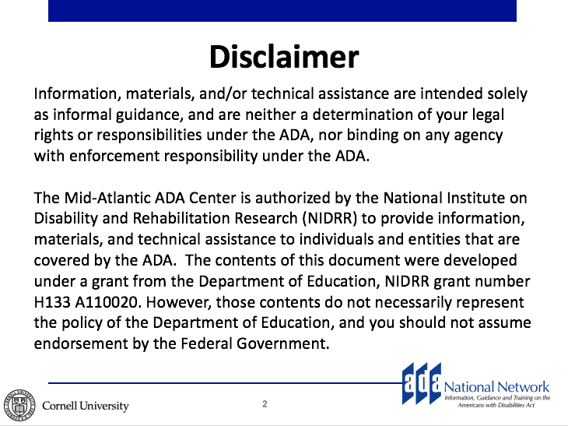

Slide 10
Legislative Timeline
1964 – Civil Rights Act (did not include disability)
1968 – Architectural Barriers Act
1973 – Rehabilitation Act
1975 – Individuals with Disabilities in Education Act (IDEA)
1986 – Air Carrier Access Act
1988 – Fair Housing Amendments Act
1990 – Americans with Disabilities Act
2008 – ADA Amendments

Slide 11
Who has rights under the ADA?
Applies to People Who:
Have a disability
Record of / regarded as having a disability
Have an association with a person with a disability
A disability is defined is a physical or mental impairment that substantially limits one or more major life activities

Slide 12
Five Titles of the ADA
Title I. Employment
Prohibits disability discrimination in all employment processes
Title 2. Accessibility in Public Entities
Physical and program accessibility in state / local government entities
Title 3. Accessibility in Business
Physical and program accessibility in restaurants, hotels, stores, places of business
Title 4. Telecommunications
Telephone and communication systems for the public
Title 5. Miscellaneous
Protection from retaliation

Slide 13
Who is “covered” (must comply with) the ADA
Entities with 15 or more employees
Public (government) agencies regardless of whether or not they receive federal assistance
Privately operated commercial entities (for example, private schools and colleges, banks, restaurants, theaters, hotels, private transportation, supermarkets, shopping malls, museums, recreational facilities, sports arenas, medical, legal, and insurance offices)
Exempt: Private clubs and religious organizations

Slide 14
Neurological Disabilities
(Alzheimer’s, Epilepsy, Cerebral Palsy, TBI, Stroke
May Affect:
Physical functioning
Interactions with others
Learning and memory
The effects of each disability are unique to every individual

Slide 15
Physical and Mobility Disabilities
Includes any impairment that impacts a person’s use of their body or limbs
May involve using mobility devices, prosthetics, and other equipment to aid in performing tasks

Slide 16
Speech Disabilities
2.6 million people have difficulty having their speech understood
Can arise from different causes
Speech disabilities can sometimes be accompanied by facial muscle and/or vocal inflections

Slide 17
Learning Disabilities
LD is a childhood disorder characterized by difficulty with certain skills such as reading or writing and math
LD may affect the ability to interpret what one sees or hears or the ability to link information from different parts of the brain

Slide 18
Psychiatric Disabilities
Examples: Depression, Anxiety Disorder, Bipolar Disorder, Schizophrenia
Most mental illnesses are treatable
Psychiatric disabilities are the result of a brain disorder

Slide 19
PTSD, Depression, and TBI
PTSD:
Approx. 20% of returned veterans screened positive for PTSD or depression
TBI:
A common veteran injury
Every TBI is different and has different effects, often invisible effects

Slide 20
Visual Disabilities
1.8 million people have a severe visual impairment or blindness
Varying levels of visual disability
Not all people with visual disabilities read Braille

Slide 21
Hearing Disabilities
1 million Americans have trouble hearing normal conversation, the number sharply increases with age
30% of people over age 65 have difficulty hearing
Varying degrees of hearing disabilities

Slide 22
Intellectual Disabilities
Characterized by lower test of functional and mental ability
Can arise from many different causes
Not always present with other developmental disabilities

Slide 23
Remember...
The same disability can affect different people in very different ways
The ADA impacts all different types of disability. We’re all in this together.

Slide 24
Daniel went to a popular restaurant. He has a learning disability that makes reading difficult for him. When the server offered Daniel a menu, he declined and asked the server instead to verbally describe his menu options. The server said, ”It’s all on the menu”, dropped the menu on the table, and stepped away.
Is this situation covered under the ADA? If so, what Title?

Slide 25
Rodney, an individual with a hearing impairment, is starting classes to obtain a real estate broker license. When he attends the first class, Rodney discoveres that he cannot hear the instructor, so he asks for an assistive learning device. The private company that offers the class refuses to provide the device.
Is this situation covered under the ADA? If so, what Title?

Slide 26
Nina, an individual who is blind, uses her city’s fixed bus route system. She is frustrated because the drivers do not consistently announce the bus stops. This makes it more difficult for Nina to independently find her way to destinations.
Is this situation covered under the ADA? If so, what Title?

Slide 27
Rhonda is a double amputee who uses prosthetics on both legs. She would like to get a service dog to assist her with balance and retrieving items. The property manager at the private apartment complex where she lives is refusing to allow her to keep a dog in her apartment, citing “no pets” policy.
Is this situation covered under the ADA? If so, what Title?

Slide 28
Regina, a software engineer, has diabetes. Her employer, a large firm, frequently requires her to work late, with little to no advance notice. Because of this, Regina is not able to eat dinner at a consistent time resulting in dangerous fluctuations of her blood sugar level.
Is this situation covered under the ADA? If so, what Title?

Slide 29
Kaitlyn’s doctor’s office calls her to schedule an appointment to review her options for addressing her recent cancer diagnosis. She is understandably concerned and tells the receptionist that her husband, who is deaf, will be accompanying her to the appointment. She asks that the office provide a sign language interpreter so that her husband can participate in the appointment.
Is this situation covered under the ADA? If so, what Title?

Slide 30
Naomi is applying for a job at a large department store. While completing the application, she discovers there is a question asking if she has a disability.
Is this situation covered under the ADA? If so, what Title?

Slide 31
Tim, a wheelchair user, is traveling by air. The airline charged him a baggage fee to transport his wheelchair.
Is this situation covered under the ADA? If so, what Title?

Slide 32
Cyvil is a public high school student who is paraplegic. His school has a swimming pool that was built in the 1980s. Cyvil would like to participate in the community swimming classes offered at the school. Although he can get to the pool area in his wheelchair, there is no accessible way for him to get in and out of the pool. His parents have asked to school to provide a portable lift that will allow Cyvil to enter and exit the pool and attend the same swimming class as his peers.
Is this situation covered under the ADA? If so, what Title?

Slide 33
Chris and his friend Pete go to the local movie theater to check out the new action film. Pete uses a wheelchair. Although the theater offers accessible seating where Pete can stay in his wheelchair and Chris can sit next to him, it’s closer to the screen than either of them prefers.
Pete leaves his wheelchair accessible seating area and sits a couple of rows back in a “regular” seat. Shortly before the movie starts, a theater employee tells Pete that he has to sit in his wheelchair and if he does not comply, he and Chris will need to leave.
Is this situation covered under the ADA? If so, what Title?

Slide 34
Your Rights & The ADA
Exercise your rights!
The ADA was passed due to the hard work of disability rights activists before us. Now it’s our turn to carry on the work!
The ADA should and will evolve to meet our society’s needs, such as accessible technology.
The law is static and means nothing if we don’t take ownership of the ADA and our rights under the ADA. Only then does it become a living, breathing law that ensures every individual is included and valued.
We have the power to advocate for and transform disability rights over the next 30 years and beyond.

Slide 35


Slide 36
hannah_v@tndisability.org tonya_b@tndisability.org 615-383-9442

Slide 37


